Slide 1
Incremental motion vectors
2D motion fields
Optic Flow
KLT Tracker

Slide 2
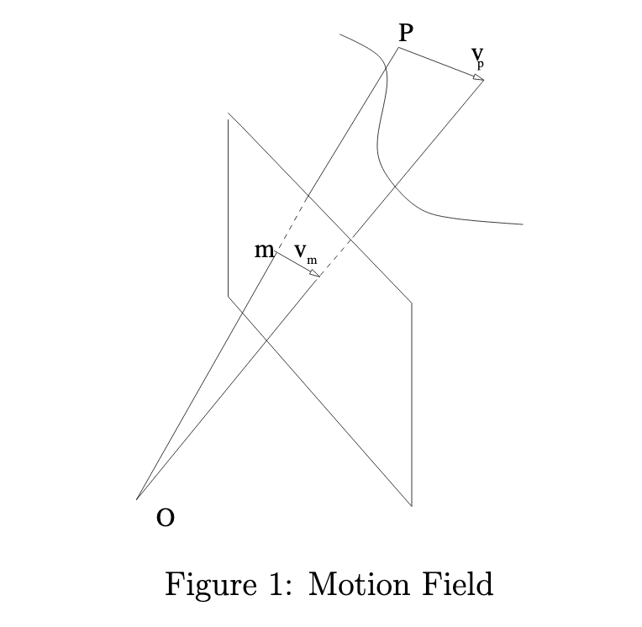
Motion Field: projection of 3D relative velocity vectors onto the 2D image plane.

Slide 3
Optic Flow: observed 2D displacements of local brightness patterns in the image.
Motion field is what we want to know.
Optic flow is what we can estimate.
Sometimes optic flow is a good approximation to the unknown motion flow.

Slide 4
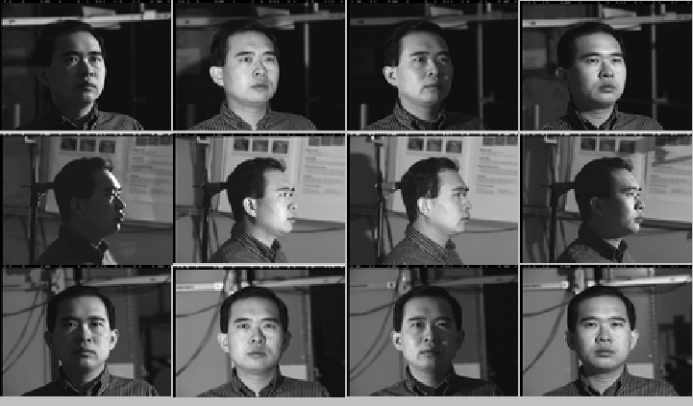
Optic flow is NOT equal to Motion field

Slide 5
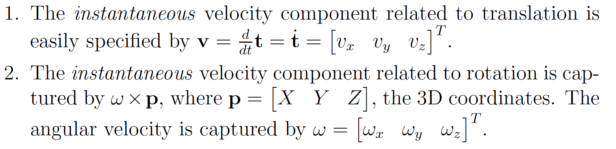
Instantaneous motion

Slide 6
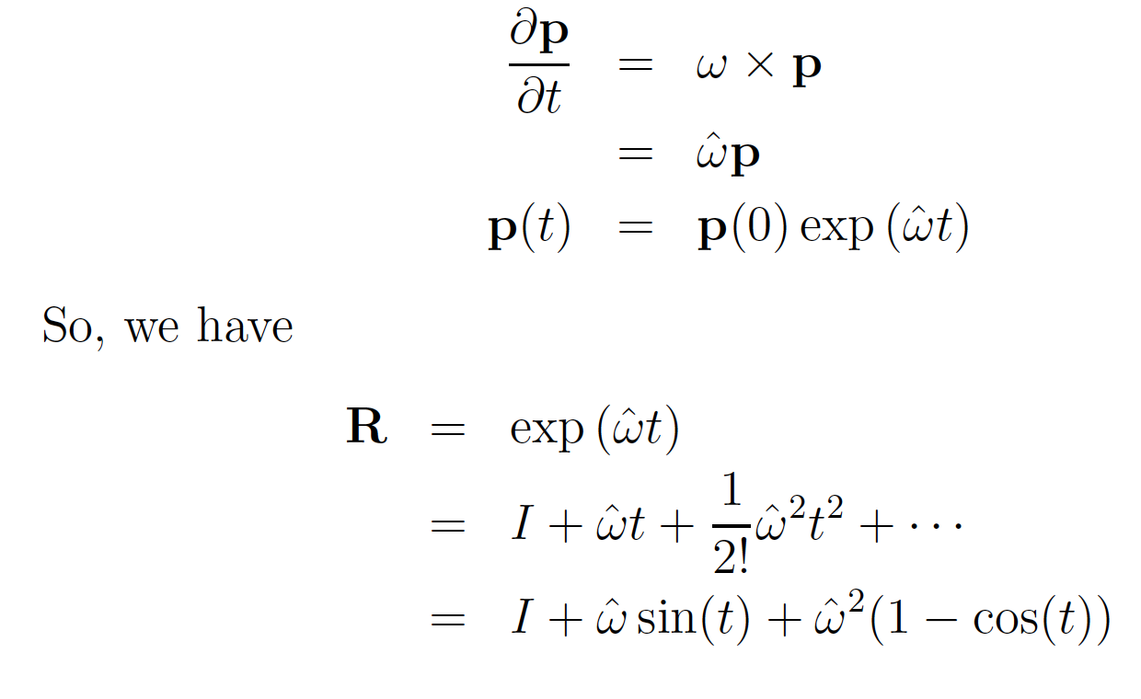
Relationship between R and ω

Slide 7
Motion Field: projection of 3D relative velocity vectors onto the 2D image plane.

Slide 8
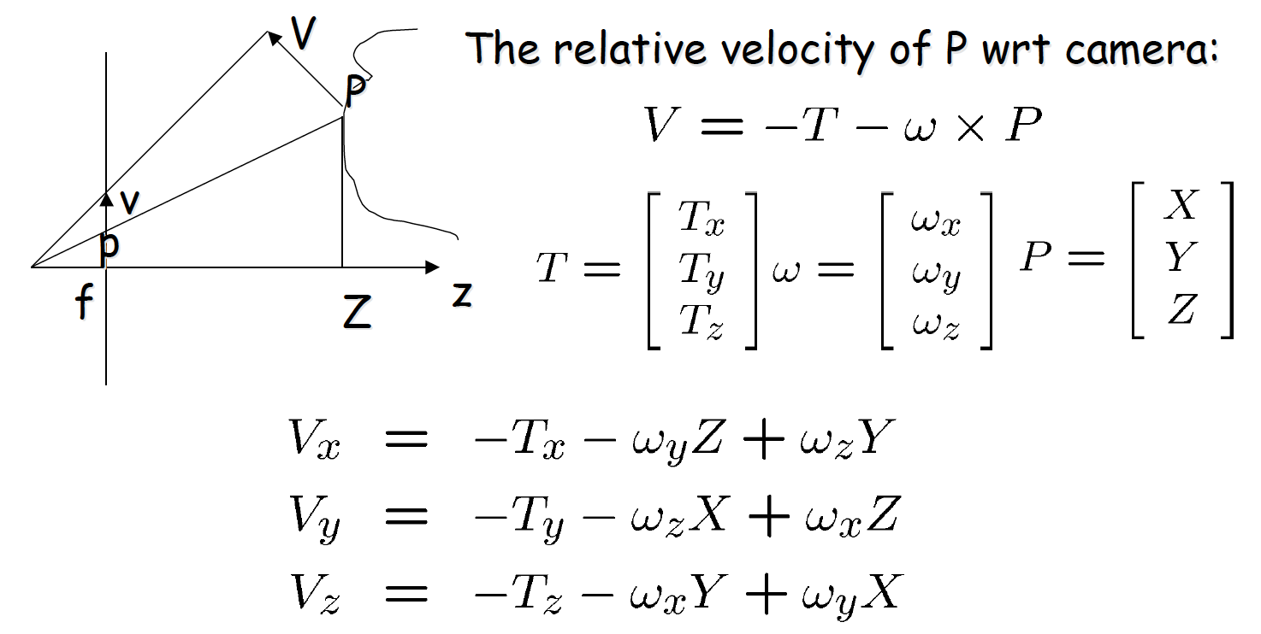
Instantaneous 3D motion vector
Credit for slide: Octavia Camps

Slide 9
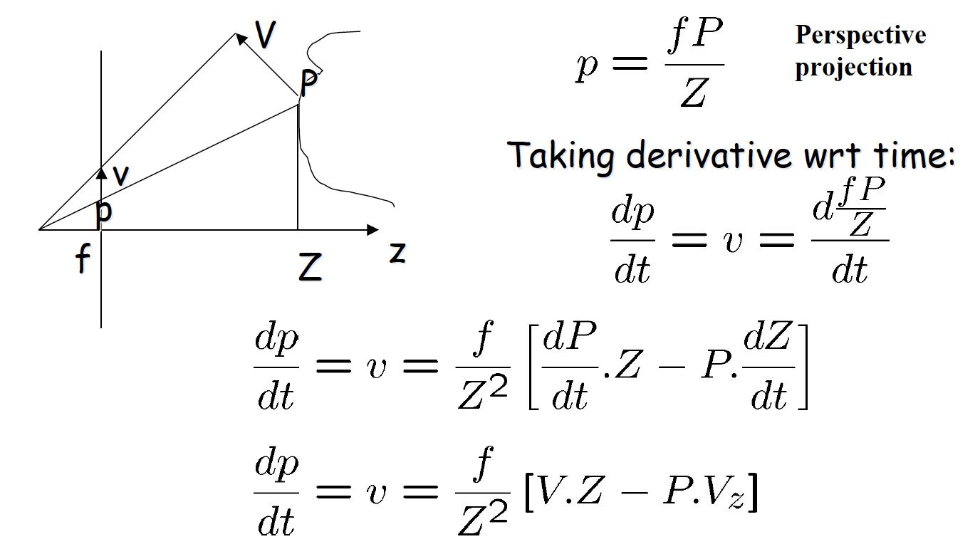
Motion field: velocity of point p in image
Credit for slide: Bob Collins and Octavia Camps

Slide 10
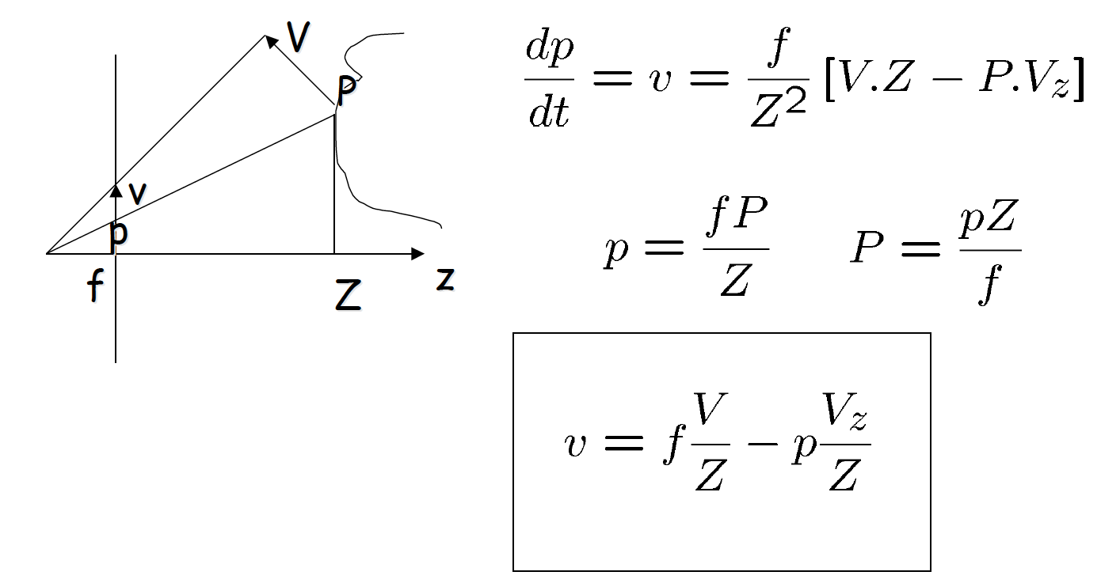
Motion field: velocity of point p in image
Credit for slide: Bob Collins and Octavia Camps

Slide 11
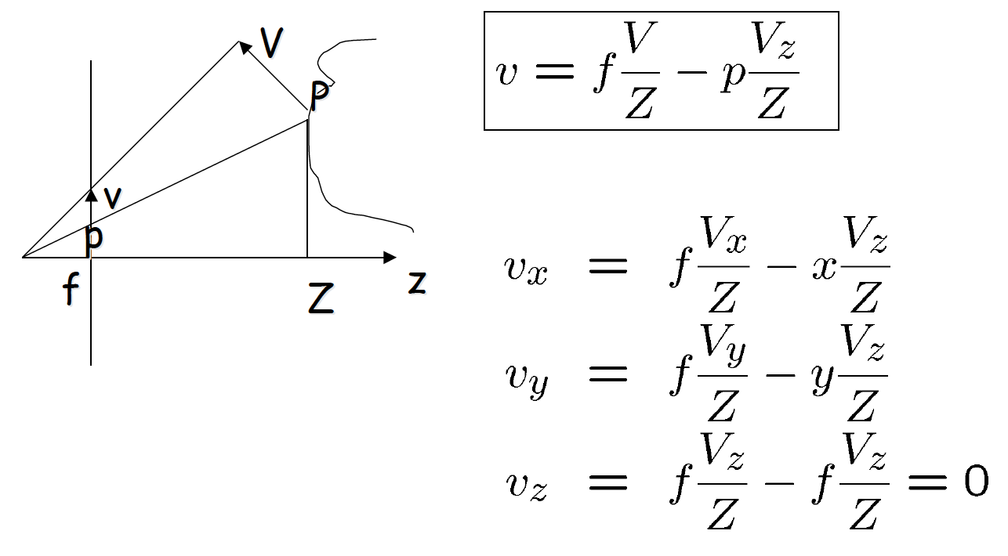
Motion field: velocity of point p in image
Credit for slide: Bob Collins and Octavia Camps

Slide 12
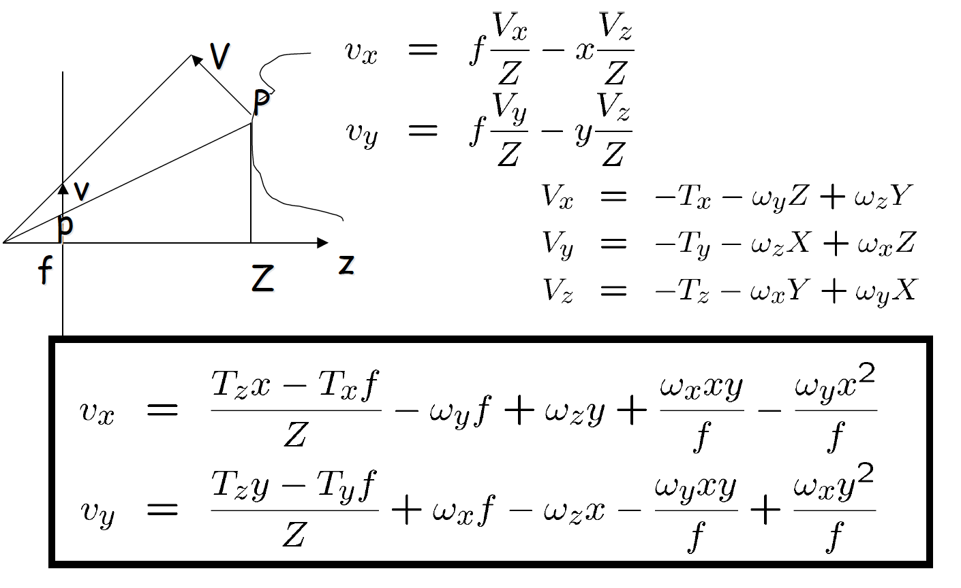
Motion field: velocity of point p in image
Credit for slide: Octavia Camps

Slide 13
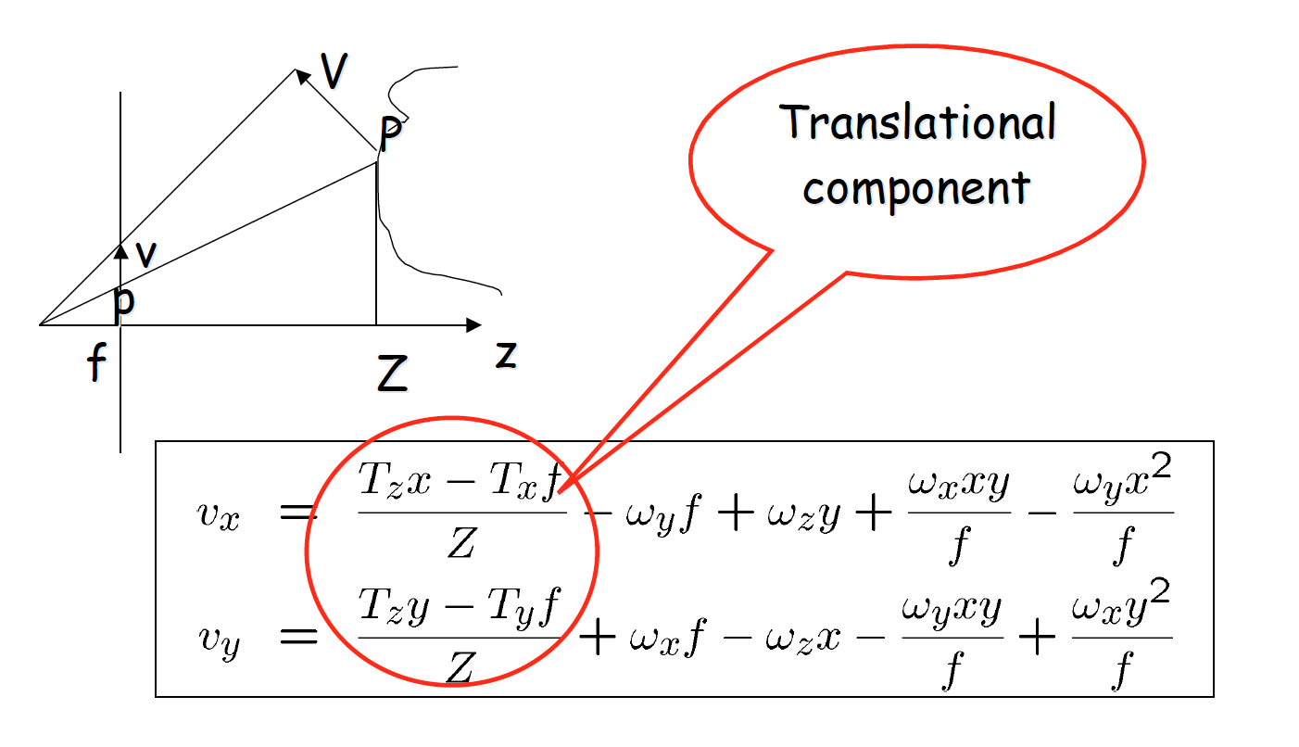
Credit for slide: Bob Collins and Octavia Camps

Slide 14
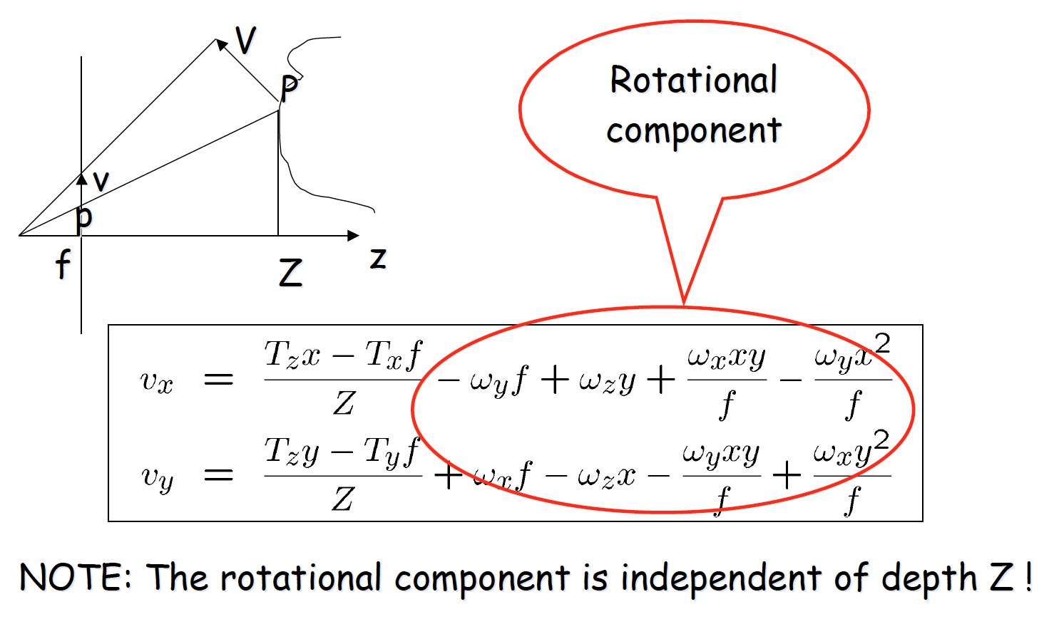
Credit for slide: Bob Collins and Octavia Camps

Slide 15
Pause: 5 min
Special Case 1 – Just Translations
What is the expression of the projected vectors when ω = 0, i.e. we have just translation? Where is the project velocity zero? Draw the pattern of the field.
(Please solve this on a piece of paper and upload solution as worksheet for this lecture after completing this lecture.)

Slide 16
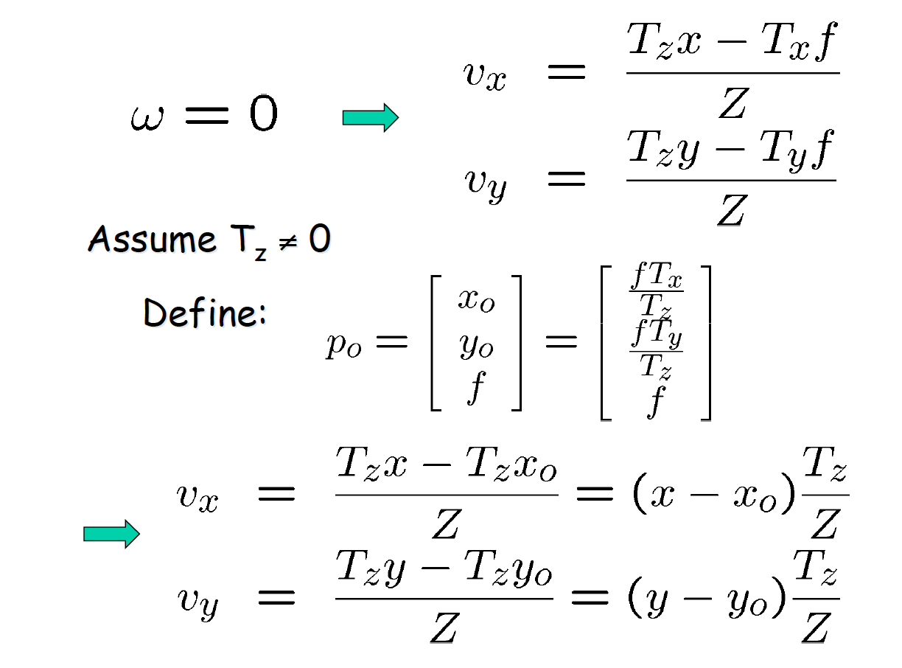
Credit for slide: Bob Collins and Octavia Camps

Slide 17
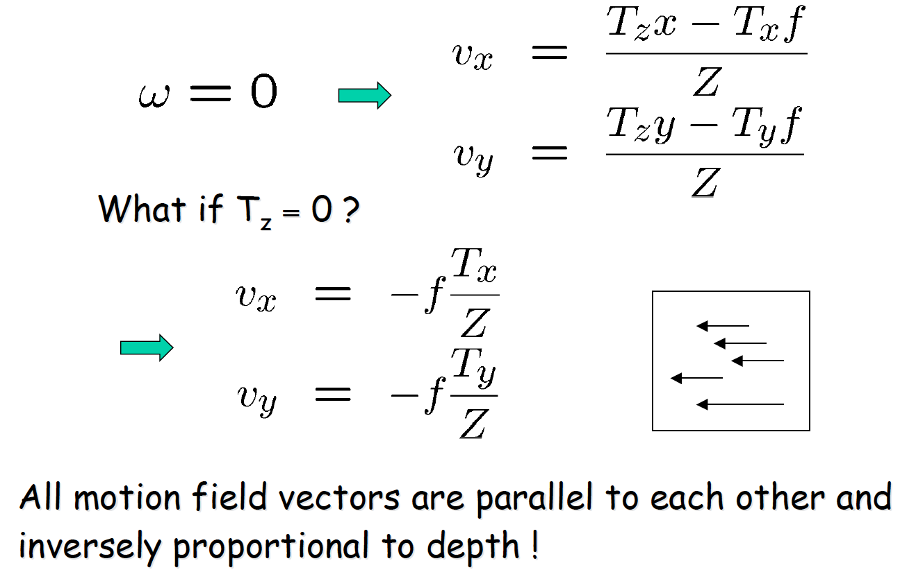
2D motion field for pure translation
Credit for slide: Bob Collins and Octavia Camps

Slide 18
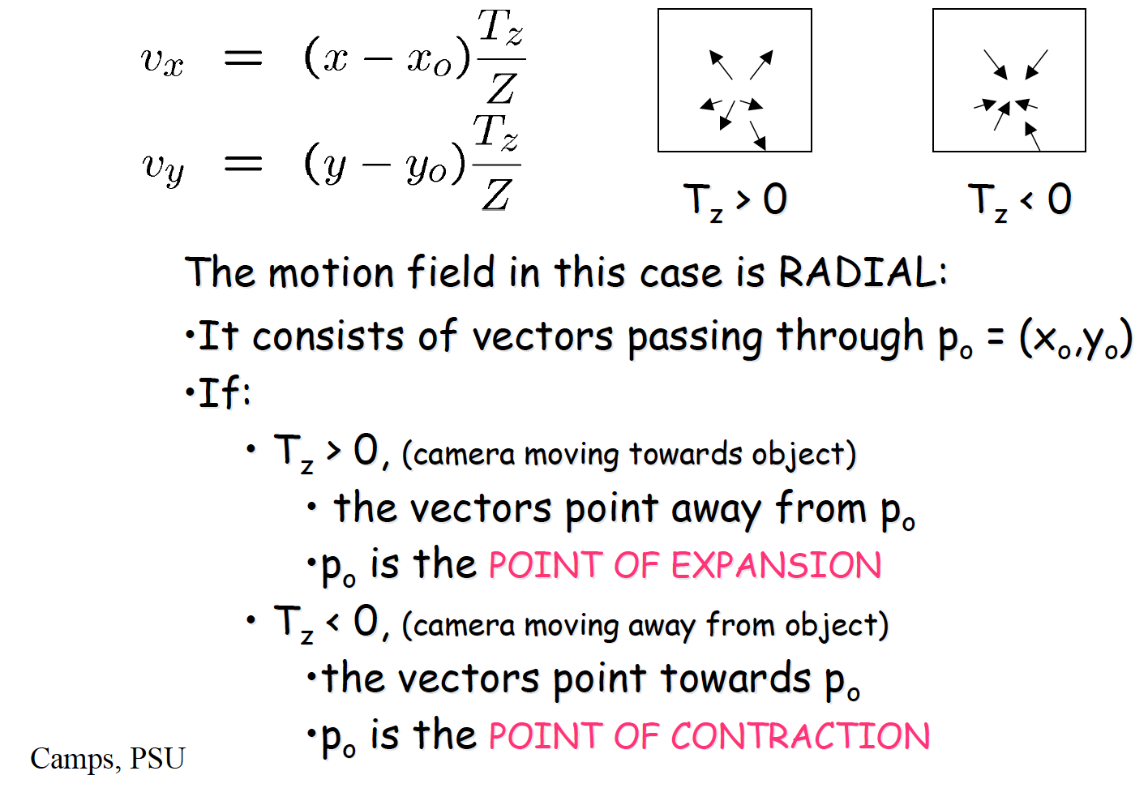
Credit for slide: Bob Collins and Octavia Camps

Slide 19
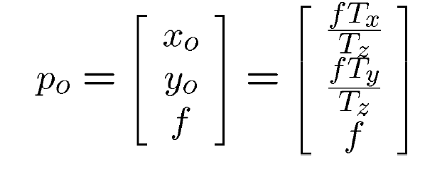
Estimating 3D translation from motion field
p_{o} is the vanishing point of the direction of translation.
p_{o} is the intersection of the ray parallel to the translation vector and the image plane.

Slide 20
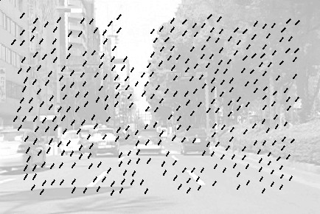
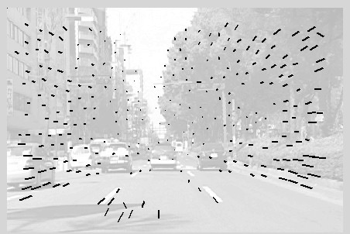
Examples
Rotation component
Translation component
Credit for slide: Bob Collins and Octavia Camps

Slide 21
Special Case II: Moving Plane
V
P
Planar surfaces are common in man-made environments
n
v p
f
Z
z
Question: How does the MF of a moving plane look like?
Credit for slide: Bob Collins and Octavia Camps

Slide 22

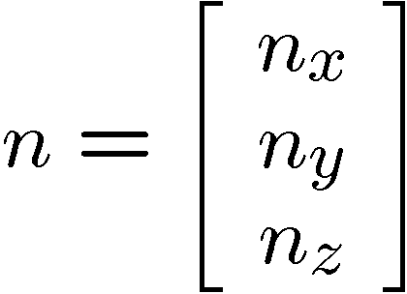
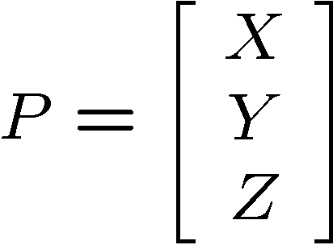
Special Case II: Moving Plane
Points on the plane must satisfy the equation describing the plane.
n
X
P
Let
•n be the unit vector normal to the plane.
•d be the distance from the plane to the origin.
•NOTE: If the plane is moving wrt camera, n and d are functions of time.
d
Y
O
Z
Then:
where
Credit for slide: Bob Collins and Octavia Camps

Slide 23
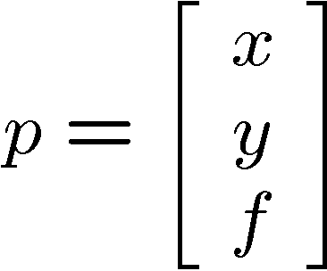
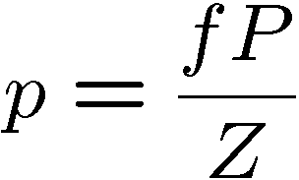
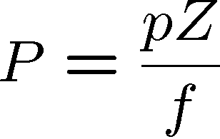
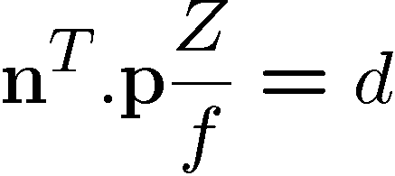
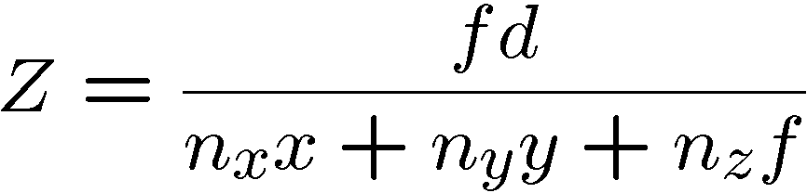
Special Case II: Moving Plane
X
be the image of P
Using the pinhole projection equation:
Let
n
d
P
p
Y
O
Z
Using the plane equation: Solving for Z:
Camps, PSU
Credit for slide: Bob Collins and Octavia Camps

Slide 24
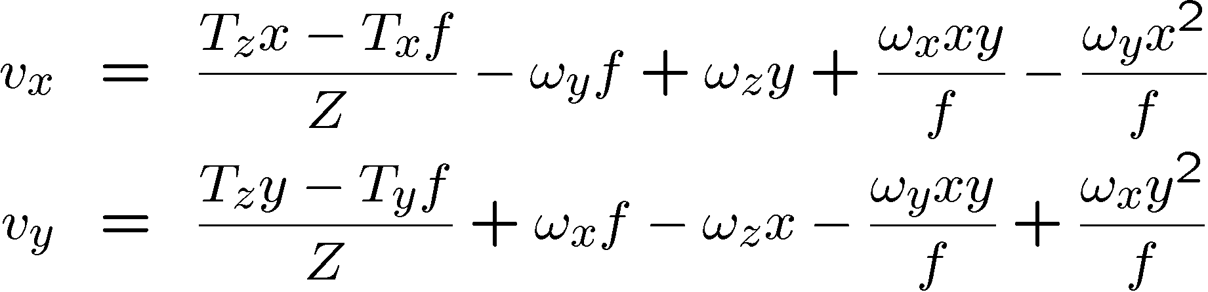
Special Case II: Moving Plane
X
Now consider the MF equations:
n
d
P
p
Y
O
Z
And Plug in:
Credit for slide: Bob Collins and Octavia Camps

Slide 25
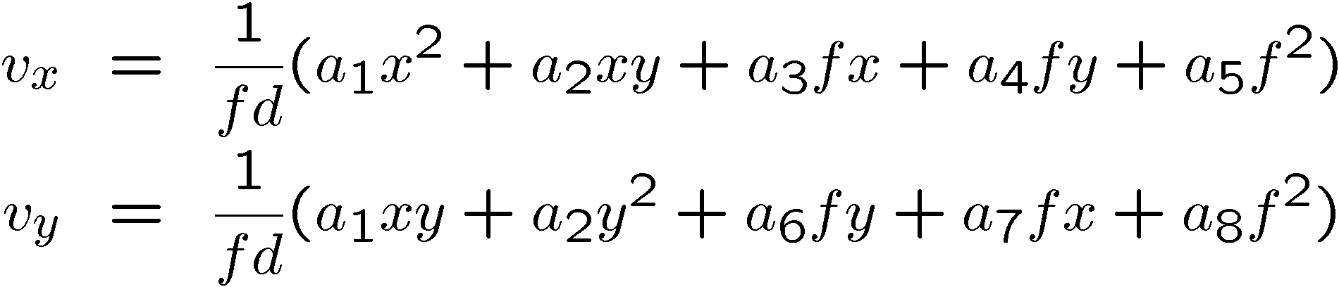
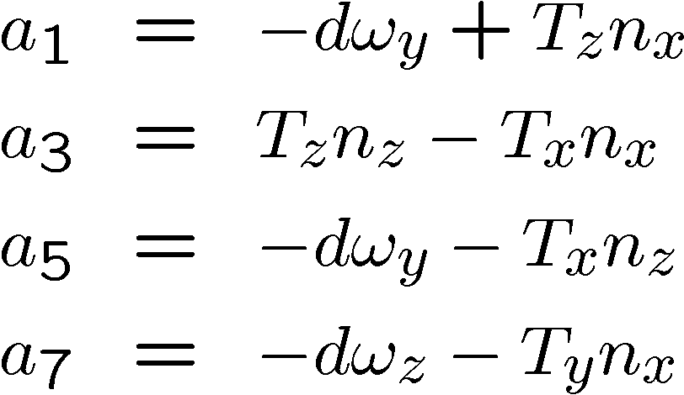
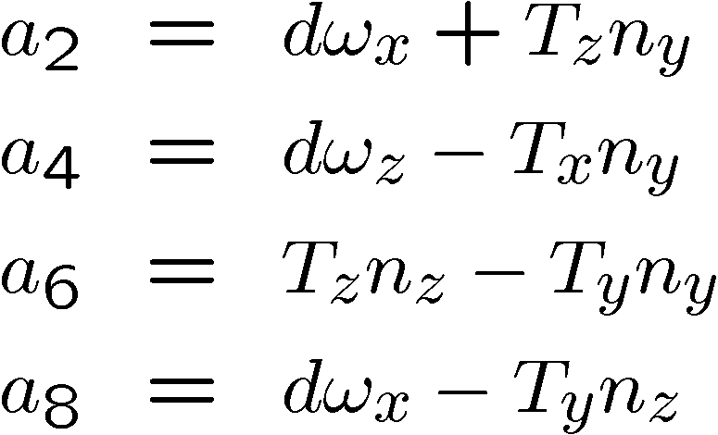
Special Case II: Moving Plane
X
The MF equations become:
n
d
P
p
Y
O
Z
where
Credit for slide: Bob Collins and Octavia Camps

Slide 26
Special Case II: Moving Plane
X
MF equations:
n
d
P
p
Y
O
Z
Q: What is the significance of this?
A: The MF vectors are given by low order (second) polynomials.
•Their coeffs. a₁ to a₈ (only 8 !) are functions of n, d, T and ω.
•That is, can estimate 8 param global flow rather than 2 params per pixel! Huge savings in time and robustness.
Credit for slide: Bob Collins and Octavia Camps

Slide 27
Optic Flow
We cannot directly observe 3D motion vectors so we have to estimate them from intensity variation due to motion, i.e. optic flow.

Slide 28

Brightness Constancy Equation
consider a scene point moving through an image sequence
I(x,y,1)
I(x,y,2) I(x,y,k)
(x(2),y(2))
(x(k),y(k))
(x(1),y(1))
Claim: its brightness/color will remain the same (that’s partly how we can recognize that it IS the same point)
$$I\left(x\left(t\right), y\left(t\right), t\right)=constant$$
Credit for slide: Bob Collins and Octavia Camps

Slide 29

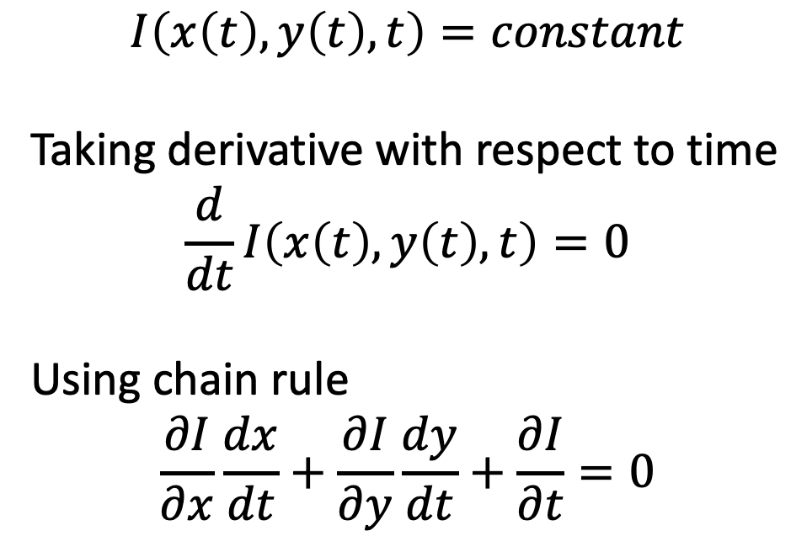
Brightness Constancy Equation
$$I\left(x\left(t\right), y\left(t\right), t\right)=constant$$
Taking derivative with respect to time
$$\frac{d}{dt}I\left(x\left(t\right), y\left(t\right), t\right)=0$$
Using chain rule
$$\frac{∂I}{∂x}\frac{dx}{dt}+\frac{∂I}{∂y}\frac{dy}{dt}+\frac{∂I}{∂t}=0$$

Slide 30
Implications: Aperture problem
The component of the flow in the gradient direction is determined (called Normal Flow)
The component of the flow parallel to an edge is unknown
Credit for slide: Bob Collins and Octavia Camps

Slide 31
The Aperture Problem
Credit for slide: Bob Collins and Octavia Camps

Slide 32
The Aperture Problem
Credit for slide: Bob Collins and Octavia Camps

Slide 33
The Aperture Problem
Credit for slide: Bob Collins and Octavia Camps

Slide 34
The Aperture Problem
Credit for slide: Bob Collins and Octavia Camps

Slide 35
The Aperture Problem
The Image Brightness Constancy Assumption only provides the OF component in the direction of the spatial image gradient
Credit for slide: Bob Collins and Octavia Camps

Slide 36
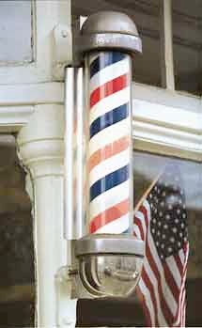
Aperture Problem: Barber-pole Illusion.
Apparent motion is this direction
True motion is this way
Credit for slide: Bob Collins

Slide 37
Optical Flow ≠ Motion Flow
The aperture problem reminds us once again that optical flow is not the same thing as motion flow.
Near an edge, we can only observe (measure) the component of flow perpendicular to the edge
Cannot measure the component of flow parallel to the edge.
Another case of non-observability of optical flow is in areas of constant intensity.
No flow is observed.
Credit for slide: Bob Collins and Octavia Camps

Slide 38
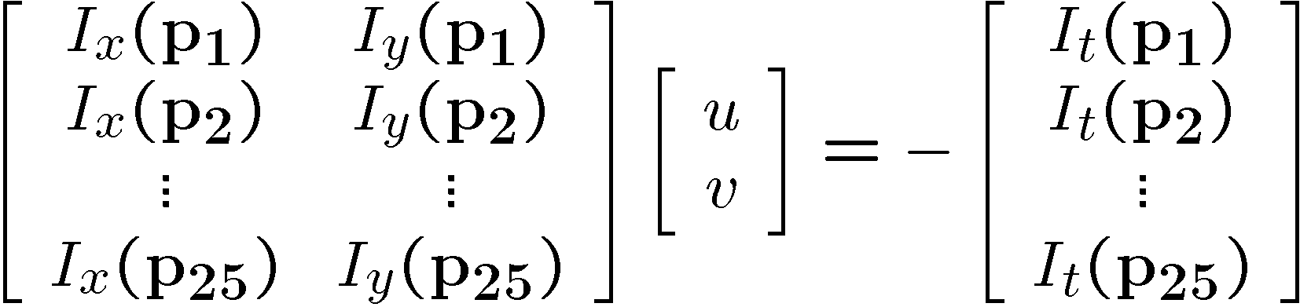






Solving the aperture problem: Lucas-Kanade
Problem – only equation per pixel.
Assume 2D flow is a constant over a small region, then
If we use a 5x5 window, that gives us 25 equations per pixel!
Credit for slide: Steve Seitz, Bob Collins and Octavia Camps

Slide 39






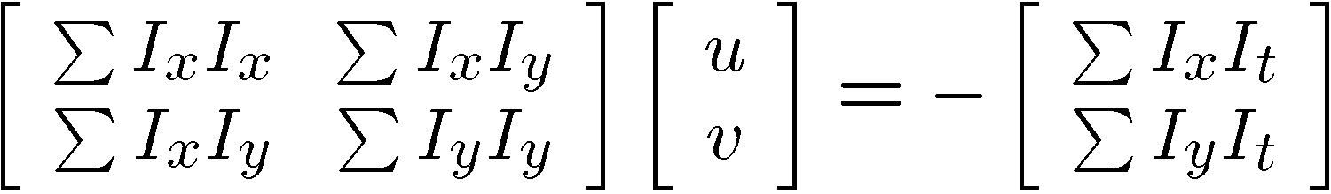


Lucas-Kanade flow
– Summations over all pixels in the KxK window
Credit for slide: Steve Seitz, Bob Collins and Octavia Camps

Slide 40
Conditions for solvability
– Optimal (u, v) satisfies Lucas-Kanade equation
When is This Solvable?
A^{T}A should be invertible
A^{T}A should not be too small due to noise
eigenvalues λ₁ and λ₂ of A^{T}A should not be too small
A^{T}A should be well-conditioned
λ₁/ λ₂ should not be too large (λ₁ = larger eigenvalue)
Credit for slide: Steve Seitz, Bob Collins and Octavia Camps

Slide 41
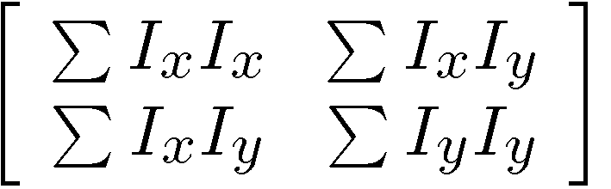
Does A^{T}A seem familiar?
Harris Corner Detector Matrix!
Credit for slide: Steve Seitz, Bob Collins and Octavia Camps

Slide 42
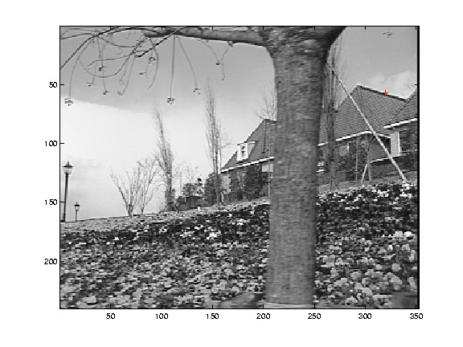
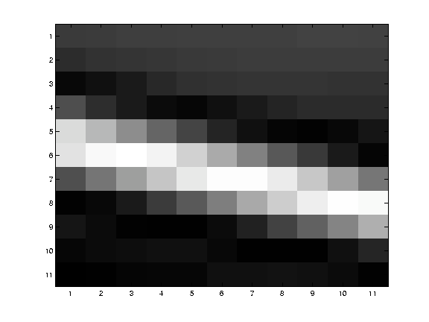
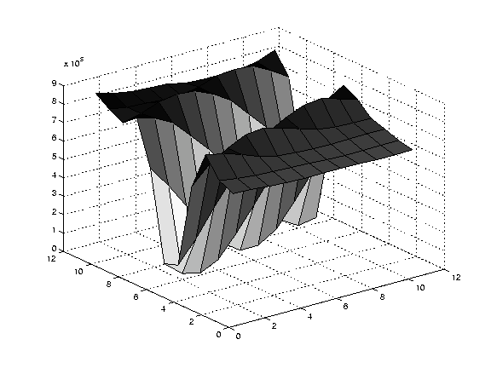
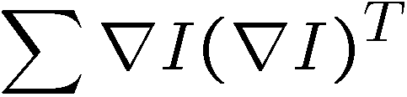
Edge
large gradients, all the same
large λ₁, small λ₂
Will have aperature problem
Credit for slide: Steve Seitz, Bob Collins and Octavia Camps

Slide 43
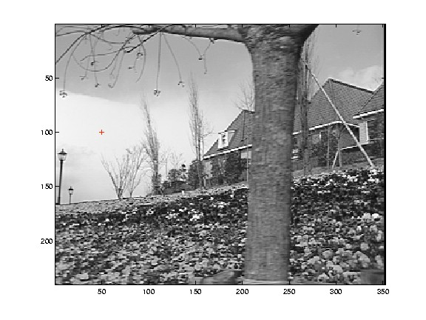
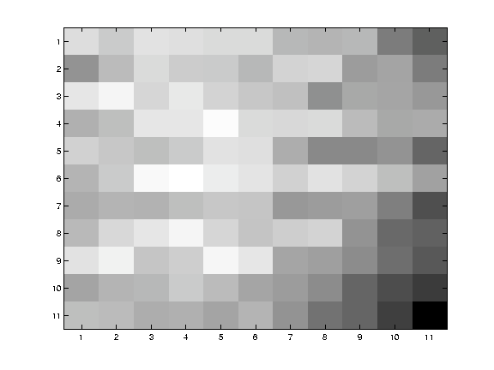
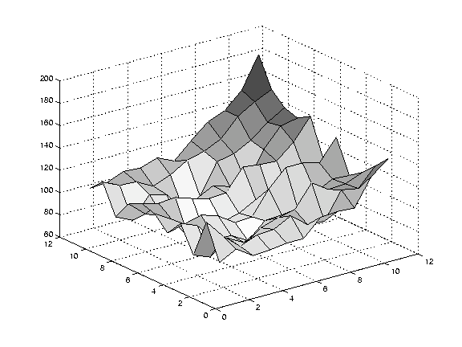
Low Texture Region
– gradients have small magnitude
– small λ₁, small λ₂
Ill-conditioned matrix. Likely to compute garbage answer.
Credit for slide: Steve Seitz, Bob Collins and Octavia Camps

Slide 44
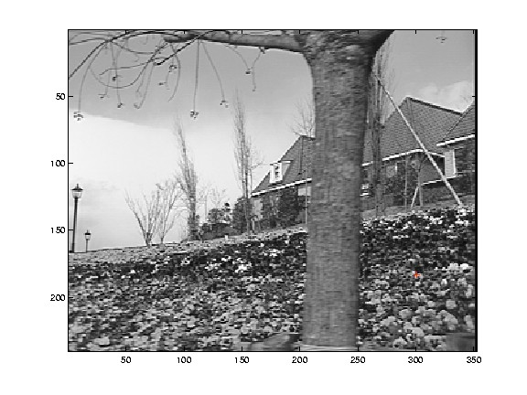
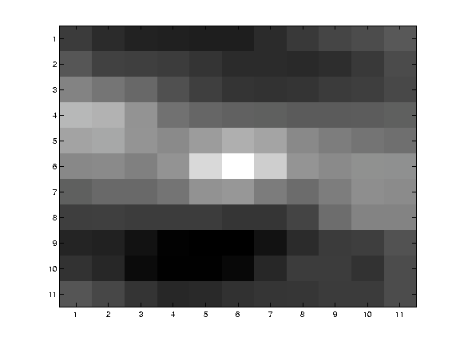
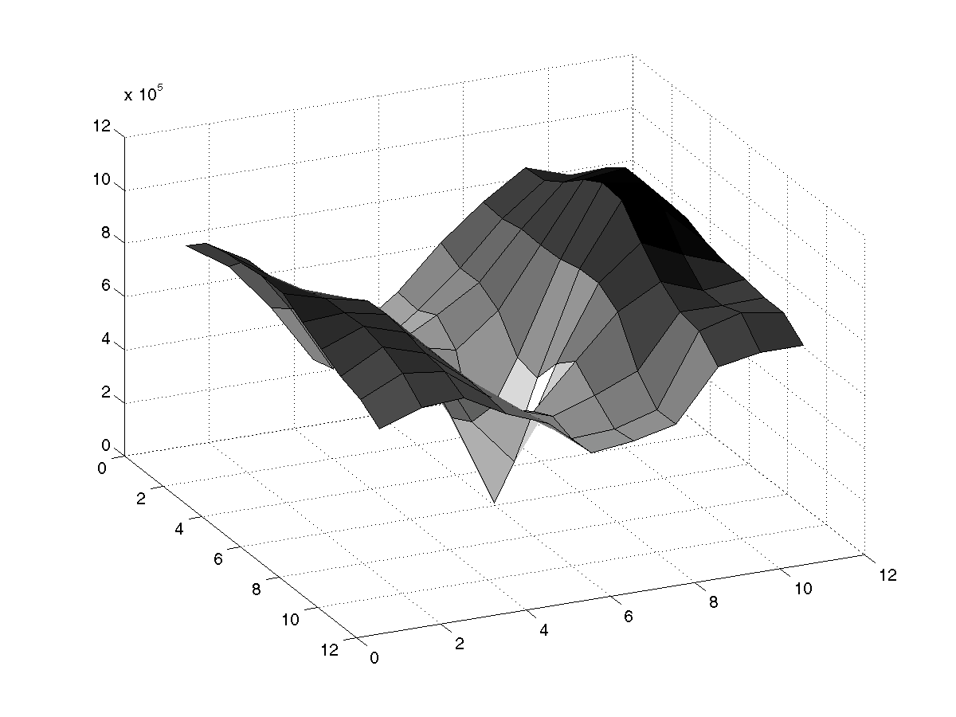
Corner
– gradients are different, large magnitudes
– large λ₁, large λ₂
Good corner feature. Also good place to estimate flow!
Credit for slide: Steve Seitz, Bob Collins and Octavia Camps

Slide 45
Kanade-Lucas-Tomasi (KLT) Algorithm
Public-domain code by Stan Birchfield.
Available from
http://www.ces.clemson.edu/~stb/klt/
Tracking corner features through 2 or more frames
Credit for slide: Steve Seitz, Bob Collins and Octavia Camps

Slide 46
KLT Algorithm
Find corners in first image
Extract intensity patch around each corner
Use Lucas-Kanade algorithm to estimate constant displacement of pixels in patch
Niceties
Iteration and multi-resolution to handle large motions
Subpixel displacement estimates (bilinear interp warp)
Can track feature through a whole sequence of frames
Ability to add new features as old features get “lost”
Credit for slide: Steve Seitz, Bob Collins and Octavia Camps

Slide 47
Other References
A good writeup about motion fields and optic flows: http://users.eecs.northwestern.edu/~yingwu/teaching/EECS432/Notes/optical_flow.pdf
http://vision.middlebury.edu/flow/
https://opencv-python-tutroals.readthedocs.io/en/latest/py_tutorials/py_video/py_lucas_kanade/py_lucas_kanade.html

